Slide 1
Dimension Modeling for Data Warehouse
Lesson 2: Understanding Business Requirements

Slide 2
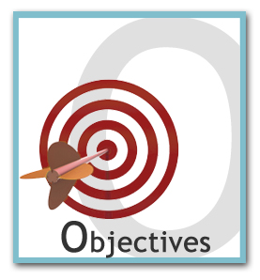
Lesson Objectives
This lesson will provide overview of various techniques of Requirement gathering
We will learn about:
Need of Requirement Analysis
The Data Life cycle
Ways of Collecting requirement
Business Requirement Specification (BRS)

Slide 3
2.1: Collecting Requirements Requirements Collection
Experts think that the requirement gathering should be treated as a separate phase.
Though, some suggest that it should be a part of the conceptual design phase.
The requirement phase is used for the following:
Collecting the business requirement
Formulating the understanding of requirement
Requirement analysis starts as soon as a business case is prepared or received.

Slide 4
2.2: Understanding Requirements Understanding Business Requirements
Any system is usually developed in response to a problem, an opportunity, or a requirement.
Its statement should be supported by a formal business case. The case is used for the following:
It is important to understand the data life cycle in an application.
Studying benefits of proposed system
Providing the logical starting of the project for modeler
Understanding the problem statement
Estimating the cost
Notes:
Understanding Business Requirements:
Typically, the business case:
Estimates the costs and benefits
Studies the risks of alternative approaches
Recommends a particular direction
Provides the logical starting point for the modeler in understanding the context and requirements
While understanding the business case, one should specify the following very carefully:
A detailed justification of the application. Who will benefit from it? Does it have any disadvantages?
The business concepts, rule and terminology
The critical success factor to the application
The scope of the system
System size and time requirement
Performance related requirements, if any
Expected life of application
Connectivity or interface with other existing or expected applications
While understanding the requirements, a modeler needs to study the overall data life cycle and how to use the data at various stages.

Slide 5
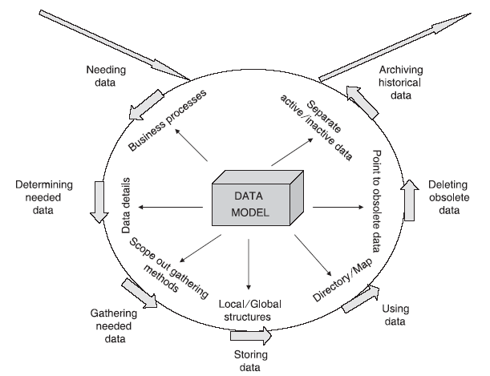
2.3: Understanding Data Life Cycle Study of Data Life Cycle
Need for data
Needed data
Collect needed data
Store data
Use data
Delete obsolete data
Archive historical data
A data life cycle help us to state the requirements clearly.
Why?
What?
How?
Notes:
Study of Data Life Cycle:
Need for Data: After the business process or a problem is identified, you need to understand the various data-related needs of the business process. The data passes through various stages and it is important to decide how to use it in every stage.
Needed Data: It is used to clearly record what data is needed to run the application. What needs to be recorded and what should be discarded. All the required details of the needed data elements are discovered and documented in the data model.
Collect Needed Data: After identifying which data is needed, collection of data takes place. Here, you apply a sort of filter to gather only the data that is needed and ignore the irrelevant data that is not necessary for any of your business processes. One needs to clearly define the various methods of collecting data.
Store Data: The collected data must be stored in the database using appropriate methods of storage. You need to decide and include the storage medium after considering the optimal storage method to suit the needs of users for accessing and using data.
Use Data: That is the ultimate goal in the data life cycle. At this stage, you perform the following activities:
Combine various data elements
Retrieve data elements for usage
Modify and store modified data
Add new data created during the business processes

Slide 6
2.3: Understanding Data Life Cycle Study of Data Life Cycle (contd..)
Notes:
Study of Data Life Cycle (contd.):
Delete Obsolete Data: After a particular time period, a particular data element in storage may become old and obsolete. After a period of time, the data element may no longer be useful and, therefore, not accessed in any transactions at all. Presence of such data in the system will slowdown the performance and introduce maintenance-related issues. Deleting such obsolete data becomes an ongoing operation. A particular data element may fall into the category qualified for deletion. At this stage, the data model is used to examine the various data elements that can be safely deleted after specified periods.
Archive Historical Data: Some data elements could be useful even after any activity on those data elements had ceased. Historical data can be used in the data warehouse of the organization. Any such useful data elements are removed from the current database and archived into a separate historical repository for further use.

Slide 7
2.4: What is a Good Software Requirement? Characteristics of a Good Requirement
Specific
Correct: A true statement of what the requirement should do
Complete: Encompass all requirements of concern to the Users
Unambiguous: Has only one interpretation
Consistent: Does not conflict with other Requirements
Verifiable: Can be tested to meet the Requirements
Attainable: It should be within the scope of the project
Understandable: Comprehendible by User, Business and Developers
Detailed/ Granular: Granular to be implemented in test cases and design
Explicit: Encompass all derived requirements
Traceable: It should be possible to trace a component requirement to its source
Manageable & Organized: Scalability and change management, should be structured
Notes:
Characteristics of a Good Requirement:
Meeting the customer’s real needs is one of the goals of developing a system. If the system does not meet the customer’s needs, then the perceived value of the system diminishes.

Slide 8



2.5: Collecting Business Requirements Collation of Business Requirements
Conduct interviews and workshops:
Avoid using data model in interviews and workshops.
Prefer UML, Use Cases, Activity Diagrams, DFD, and so on.
Conduct interviews with senior managers.
Conduct interviews with Subject Matter Experts (Do not let them Design.)
Conduct facilitated workshops.
Verify your own understanding about requirements.
Notes:
Collection of Business Requirements:
Interviews and workshops are the essential techniques for requirements gathering.
You need to be very careful about using data models as your means of communication during these initial interviews or workshops. In fact, use anything but data models: UML Use Cases and Activity Diagrams, plain text, data flow diagrams, event diagrams, function hierarchies, and/or report layouts.
CEOs and other senior managers may not be familiar with the details of process and data but are usually the best placed to paint a picture of future directions.
Business experts, end users, and “subject matter experts” are the people we consult in order to understand the data requirements in depth. Do not let them design the model—at least not yet! Instead, encourage them to explain the processes and the data they use and to examine critically how well their needs are met.

Slide 9
2.5: Interview with Stakeholders and Users Interviewing Stakeholders and Users
Ask questions to the stakeholders at a pre-decided time and venue to gather requirement knowledge:
Ask open-ended questions
Use structured agenda of fairly open questions
Interviews are good for documentation and agreement on common or discussed objectives.
Management support is required to obtain time from stakeholders.

Slide 10
2.5: Other Methods of Collecting Requirements Other Methods of Collecting Requirements
Direct Observation Techniques:
This allows you to asses users’ needs and problems associated with the use of services.
This technique is designed for a specific purpose; to identify a problem, describe a situation, assess user satisfaction, and so on.
Surveys
This is more suitable when stakeholders are spread globally.
Data Collection and Analysis
These are indirect sources of information to provide an approximation of the needs of the user.
Source can be public data, marketing data or any other data.
Notes:
Other Methods of Collecting Requirements:
Direct Observation Techniques
It reveals details which other methods cannot.
It also has limitations such as the following:
a) Extremely time consuming
b) Expensive and requires careful observation
c) Results maybe hard to analyze as it yields too much data
Surveys
Surveys are more suitable when stakeholders are spread across locations.
They are used to collect information from many users in less time.
Data Collection and Analysis
Indirect sources of information to provide an approximation of the needs of the user
Source can be public data, marketing data, or any other sources.

Slide 11
2.6: Specifying Business Requirements Business Requirements Specification
The most important task is to define “statement of requirements” or Business Requirement Specification. The issues could be as follows:
Many requirements are well-known but impractical to document them.
Some requirements are only relevant to specific design alternatives.
Some requirements may emerge only when the client has seen an actual design.
High-level business directions and rules cannot be captured directly.
Business Requirement Specification
Notes:
Business Requirements Specification:
Some of the issues with the preparation of BRS document:
Many requirements are well-known to the designer and client (“The house must be structurally sound; the shower requires both hot and cold water.”) and it would be impractical to try to document them in full.
Some requirements are only relevant to specific design alternatives (“The shelves in this cupboard should be widely spaced,” only makes sense in the context of a design that includes the cupboard).
Some requirements may emerge only when the client has seen an actual design (“I like to sleep in complete darkness.” or “I don’t want to hear the kids practicing piano.”).
high-level business directions and rules cannot be captured directly: “We need to be able to introduce new products without redesigning the system.”

Slide 12

Summary
In this module, you learned about the following:
Any system is usually developed in response to a problem, an opportunity, or a requirement.
It is important to understand the data life cycle in an application state the requirements clearly.
The most important task is to define “statement of requirements” or Business Requirement Specification.
Notes:
Add the notes here.

Slide 13

Review Question
Question 1: _____ is more suitable when stakeholders are spread globally.
Question 2: ________ are good for documentation and agreement on common or discussed objectives

